Slide 1
INDIA ROAD ACCIDENT ANALYS REPORT

Slide 2
OBJECTIVES
Analyze road accidents across India.
Find accident-prone states.
Study accident causes.
Analyze weather effects.
Compare road types.
Understand accident severity.
Suggest methods to reduce accidents.

Slide 3
DATASET OVERVIEW
:Attributes
-Accident ID
-Date
-Time
-State
-City
-Road Type
-Weather
-Lighting Condition
-Primary Cause
-Vehicle Type
-Severity
-Fatalities
-Injuries
Total Records: 1700
Total Columns: 15
States Covered: 28
Year: 2024
Total Fatalities (Deaths): 746
Total Injuries: 3,766

Slide 4
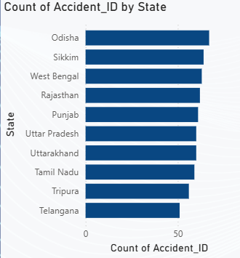
Accident Distribution by State
OBSERVATION
Odisha recorded the highest number of accidents in this dataset.
Sikkim and West Bengal also have relatively high accident counts
Telangana recorded the lowest number of accidents among the states shown in the graph.

Slide 5
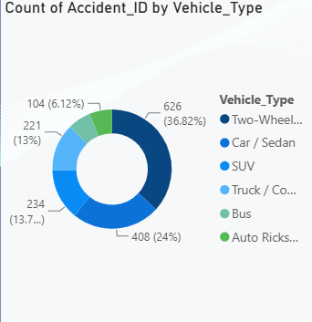
Count of Accidents by Vehicle Type
Observation
Two-Wheelers account for 626 accidents (36.82%), the highest among all vehicle types.
Cars/Sedans contribute 408 accidents (24%).
Trucks/Commercial vehicles contribute 221 accidents (13%).
SUVs account for 234 accidents (13.7%).
Buses and Auto Rickshaws have comparatively fewer accidents.

Slide 6
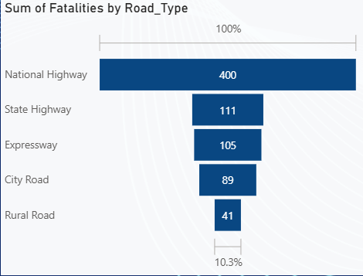
Sum of Fatalities by Road Type
Observation
National Highways recorded 400 fatalities, the highest among all road types.
State Highways recorded 111 fatalities.
City Roads recorded 89 fatalities.
Expressways recorded 105 fatalities
Rural Roads recorded 41 fatalities.

Slide 7
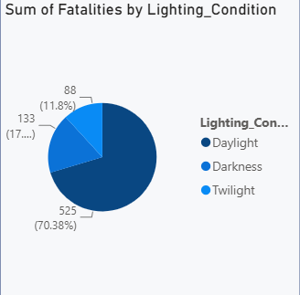
Sum of Fatalities by Lighting Condition
Observation
Daylight accounts for about 70.38% (525 fatalities)
Darkness contributes around 17.8% (133 fatalities
Twilight contributes 11.8% (88 fatalities

Slide 8
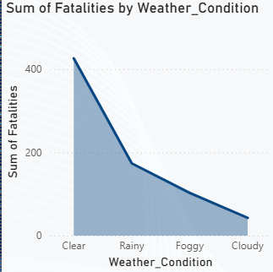
Sum of Fatalities by Weather Condition
Observation
Clear weather recorded the highest number of fatalities (around 425).
Rainy weather had significantly fewer fatalities.
Cloudy weather recorded the lowest fatalities.
Foggy weather showed a moderate number of fatalities.
Foggy weather showed a moderate number of fatalities.

Slide 9
"Why are fatalities highest during clear weather instead of rainy weather?"
"Clear weather encourages more people to travel and drivers often drive at higher speeds. Higher traffic volume and overspeeding result in more fatal accidents. During rainy or foggy conditions, people generally drive more cautiously and traffic volume is lower, reducing the total number of fatal crashes."

Slide 10
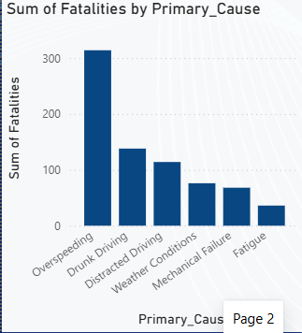
Sum of Fatalities by Primary Cause
Observation
Overspeeding is the leading cause of fatalities (over 300 deaths
Drunk driving is the second major cause
Distracted driving ranks third.
Mechanical failure and fatigue contribute the least.

Slide 11
Major Findings
Overspeeding is the leading cause of fatal road accidents.
Most fatalities occur during clear weather and daylight due to higher traffic volume.
National Highways record the highest number of fatalities because of high-speed travel.
Two-wheelers are involved in the largest share of accidents.
Accident counts vary across states, indicating the need for region-specific road safety strategies.

Slide 12
CONCLUTION
The analysis shows that road accidents are largely caused by human behavior and traffic density. By implementing stricter enforcement, improving infrastructure, and increasing public awareness, accident rates and fatalities can be significantly reduced.
The analysis of the road accident dataset across 28 Indian states provides valuable insights into the factors contributing to road accidents and fatalities. The study shows that overspeeding is the leading cause of fatal accidents, highlighting the need for stricter enforcement of speed limits and responsible driving practices.
The analysis also reveals that National Highways experience the highest number of fatalities due to high vehicle speeds and heavy traffic movement. Furthermore, two-wheelers are involved in the largest number of accidents, indicating the importance of helmet usage, rider awareness, and adherence to traffic rules.
Interestingly, the data shows that most fatalities occur during clear weather and daylight conditions. This suggests that increased traffic volume and driver negligence, rather than poor weather alone, play a major role in serious accidents. Human factors such as speeding, distracted driving, and drunk driving remain the primary reasons behind road accidents.

